Slide 1
Flappy Bird A 2d Game

Slide 2
Hello!
I am Muhammad Muzammil Zia. I am here to give presentation for my project.
Roll Number: 38
Seat Number: EB21102073
BSCS section B

Slide 3
Introduction
1
Flappy bird is a 2D game in which we are the bird and we have to fly through obstacles (pipes), passing through pipes without colliding increases the score while colliding with pipe or with the ground makes the game over. We can also collect coins which will work as game currency.

Slide 4
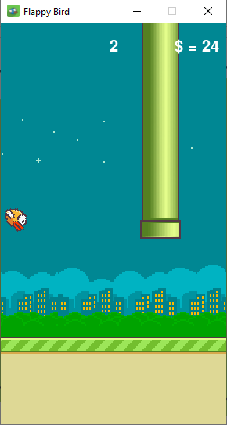
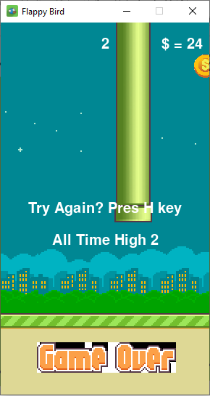
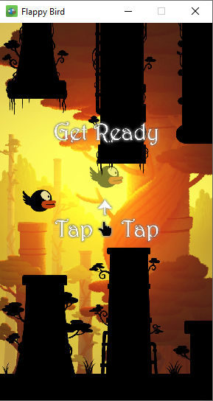

Slide 5
Libraries/modules used in the game
Pygame
Random
Basic python logic

Slide 6
Used pygame functions
.display.set_mode():
.display.set_caption():
.image.load():
.display.set_icon():
.time.clock():
,font.Font()
.transform.scale():
.transform.rotate():
.event.get()
.display.update():

Slide 7
Game Features
The game holds the record of all time best score
The game also holds the record of the total game currency (gold)
The bird have acceleration (gravity)
The game have the functionality to restart

Slide 8
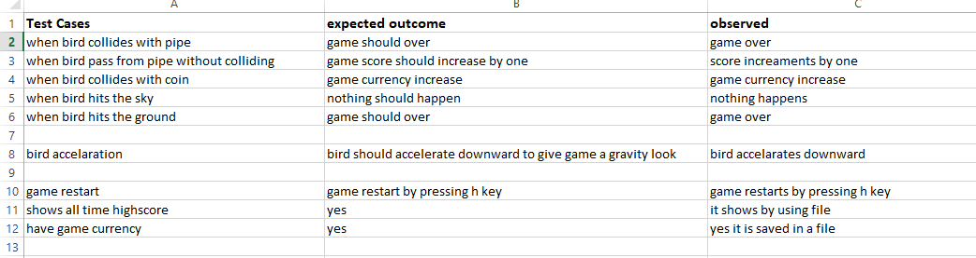
Test Cases

Slide 9
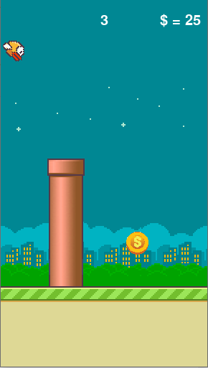
Mobile project
POV of playing my game on phone xd

Slide 10
Thanks!
Any questions?

Slide 11
Credits
Me!

